Slide 1
ENHANCING IMPACT OF FOOD FORTIFICATION PROGRAMS –
PROGRAM DESIGN, QUALITY, MONITORING AND EVALUATION
BY:
Dr. Shubhada Kanani
Professor
Dept of Foods and Nutrition
[A WHO Collaborating Centre for Research & Training in Nutrition for Health & Development]
The Maharaja Sayajirao University of Baroda
Vadodara, India
Presented at:
"Micronutrient Fortification of Foods: Science, Application & Management",
ILSI-India, Jan 7-8, 2011, New Delhi

Slide 2
FOOD FORTIFICATION (FF) :
“A silent solution to hidden hunger”
Strength of FF: When done correctly, it has no perceptible effect on the characteristics of the food.
Health and nutrition improvements result from the daily intake of imperceptible amounts of vitamins-minerals.
For the consumer, impact is hidden from the senses, as invisible and silent as micronutrient malnutrition itself
This very feature that makes FF a worthwhile intervention also makes it difficult to determine whether the program is working properly (Micronutrient Forum)
THE KEY CHALLENGE : Putting in place an implementation and monitoring –evaluation (I-ME) system which shows how to best minimize or eliminate micronutrient deficits and ensuring that the Program Plan and supporting systems work
Ref: Micronutrient Forum, 2009

Slide 3
THE EMPHASIS ON QUALITY
The significant global and national investments on producing adequate amounts of fortified food and ensuring high coverage of the population need to be matched with investments in monitoring and quality of implementation, as well as evaluation of impact on micronutrient malnutrition (MNM)
Only a quality-assured and system-wide approach to food fortification can benefit global health and nutrition at a reasonable cost
Nutri-view, 2010

Slide 4
MONITORING
The ongoing process of collecting and using standardized information to assess progress towards objectives, use of resources and achievement of outcomes and impact.
Usually involves assessment against agreed performance indicators and targets.
Provides decision makers with the information needed to ensure quality implementation and take corrective action to move towards goals
Are these conditions being met in FF programs?
What are the issues, challenges and ways forward?
Notes:
Progress towards objectives involves assessing whether the FF supplements are being consumed by the beneficiaries as intended, for the duration required (outcome) and whether there is reduction in MNM (Impact).
The targets and performance indicators would be given in the Government directives, records and registers. Finally, the crucial issue is whether there is a system in place to use the voluminous information generated to take corrective action and plug the lacunae towards sustained and desired consumption of the FFS by the beneficiaries

Slide 5
I-ME In FFS programs in Government Systems – 3 Key issues
The strong political will and government commitment in Gujarat rightly deserves appreciation; fortified food suppl. is a state wide program now in ICDS and MDM. However, we need
  Result oriented monitoring systems rather than activity oriented monitoring systems
  Appropriate job descriptions and supervision systems so that action is taken at local level rather than a mere upward movement of the data
  Focus on only the priority services critical for impact- not permitting ancillary activities take over and become ends in themselves; examples – meetings, trainings

Slide 6
‘RESULTS FRAMEWORK’ FOR I-ME*:
FFS Progams in Govt sytems
GOAL: Minimize and eventually eliminate gap between intake and requirements of MN in the vulnerable groups
STRATEGIC OBJECTIVE (service provider): To ensure sustained supply of quality FFS in quantities needed to each AWC and to each intended beneficiary family (IBF)
IR 1: Atleast 80% of IBF received required supply of the FFS for over 80% distribution days in the quarter under review
STRATEGIC OBJECTIVE (beneficiary-demand creation and compliance): To ensure consumption of FFS by over 80% of intended beneficiaries in the required amounts and for the required duration
IR 2 : Atleast 80% of IBF received gender sensitive BCC messages regarding benefits of FFS; methods of preparation and the regimen for consumption
IR 1.1: Each AWC received adequate supplies of all the types of FFS for the required days in the quarter under review
IR 2.1 : Both AWWs and Supervisors organized home visits and BCC sessions through Mahila Mandals atleast 70% of the time as per plan
MEASURE and USAID,2007
IR: Intermediate result leading to objective
Notes:
Results frameworks, sometimes called “strategic frameworks,” depict the direct causal relationships between the incremental results of the key activities all the way up to the overall objective and goal of the intervention. This clarifies the points in an intervention at which results can be monitored and evaluated.Results frameworks thus include an overall goal, a strategic objective (SO) and intermediate results (IRs).

Slide 7
Type of Fortified Food Supplements (FFS)-ICDS
Beneficiary | Name Of FFS | Frequency of distribution
Children 6-36 months (take home) 3-6 years (on-site) | Take Home Ration; or -THR : Balbhog (500 Cal) -To severely maln : 1.5 times ( 800 cal). Plus – fruits, milk in selected blocks with MM (mahila mandal) participation Hot Morning snack from premix (with MM help) Snack from fortified Atta | Selected days of the week as per protocol Selected days Daily
Pregnant, lact. women and Adol girls | Extruded fortified blended foods- (Shukhdi, Shhera and Upma premixes) | As per protocol – fixed days in week

Slide 8
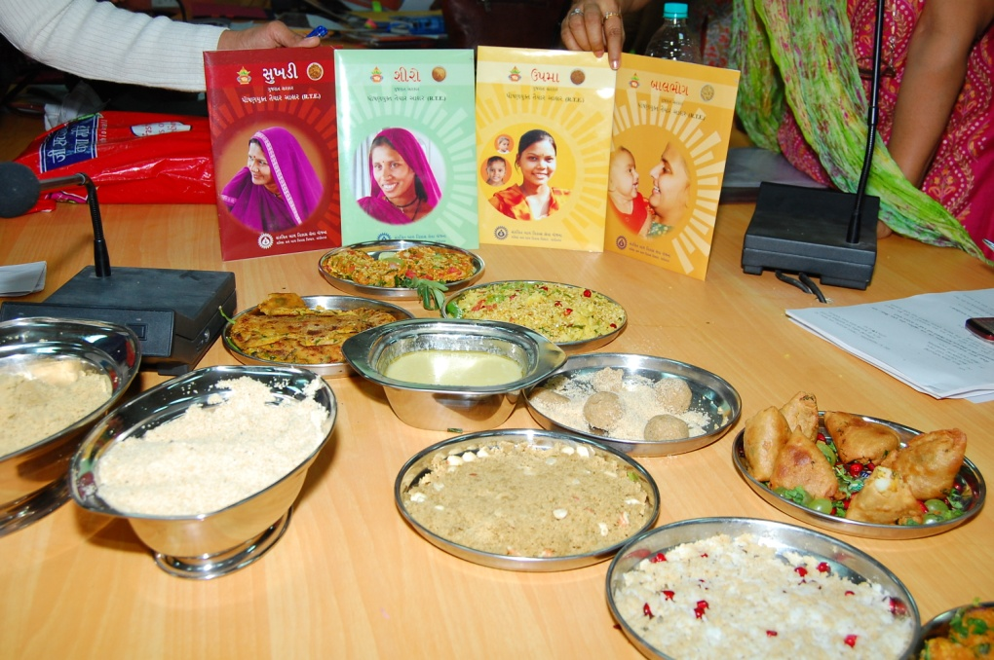
GLIMPSES OF THE FFS IN ICDS-
Govt. of Gujarat

Slide 9


Slide 10


Slide 11
ICDS-FFS MONITORING REGISTERS : TOTAL = 11*
FFS | Monitoring registers- At AW, block and district level | Purpose of the register
Balbhog Premixes- Sheero- Upma Fortified Atta ; oil, chana | -THR distribution register(6- 36mths) -THR distribution register (P,L & Adol. Girls) Utilisation register ( For onsite preparation-serving-hot snacks) | To record distribution to beneficiaries To monitor utilization of the ration
There is little focus in monitoring on ensuring compliance and the activities required for this purpose; eg. Home visits, BCC strategies *Kanani and Gandhi, 2010
Notes:
This is one part of the entire canvass of activities to be carried out. We need to look at the totality of their job functions how this impacts not only the FFS component but all other servcies as well. One critical aspect of effective implementation is the time activity pattern

Slide 12
TIME ACTIVITY PATTERN OF ICDS SUPERVISORS: Sample Feedback From 36 Supervisors
(11 Of 17 Blocks In Vadodara District)*
Activities | Average days spent in Oct, 2010 | Percent days (out of 24)
A. Office work (compilation of records, Stat. asst work, stock checking | 4 | 17
Meetings (cluster, block, others );trainings | 6 | 25
Other events –attendance, admin work ; eg Balika Smruddhi yojana, school health, Gunotsav and other schemes | 4 | 17
Monitoring at field level (mostly AWC visit, Home visit -rare) | 10 | 41
Total | 24 | 100
* Kanani and Gandhi, 2010 Note: Community contacts are negligible

Slide 13
Nature of Admin and field work – Sample feedback *
ACTIVITY IN OCTOBER ‘10 | DESRIPTION - SOME EXAMPLES
MEETINGS: | Seja (Cluster) meeting, Meeting with CDPO, Meeting for school health microplan, gunotsav, Helper meeting, with adolescent girls… VHSC of NRHM, with health dept (mamta day) Compilation of AWC records, statistical assistant work, distribution of THR/BB records, correcting mistakes of AWWs, bank and account work related to sakhi mandals; accounts related to expenses for fruit, milk, Annaprasan diwas, overseeing transport of THR/BB stock from block to AWC HIV/AIDS Related, for Stat assist work Includes in about 3 hours… Observation of AWC activities. Distribution of FFS, checking stock and distribution registers, correcting AWW mistakes, Balika Samrudhi Yojana, Khel Mahakumbh, school health, Rural dev dept (AWC repair, baby toilets), total sanitation campaign
OFFICE WORK:
TRAINING
ANGANWADI VISITS:
OTHER SCHEMES: * Kanani and Gandhi, 2010

Slide 14
I-ME SYSTEM FOR ICDS FFS PROGRAM
Mismatch :focus is on coverage not quality
Q. Are activities going on as scheduled?
Supply: Largely, Yes (MIS focuses on this aspect)
Distribution : Reach to interior AWCs a problem at times (few vehicles?)
Q. What are the problems during implementation?
Job description inappropriate; paper work takes precedence over community contacts
Community preparedness to accept and consume FFS not given priority
Q. What is the community response to the varied types of FFS?
Variable community response; Irregular collection of THR by women and adolescent girls
Matru Mandals & Sakhi Mandals
Too busy to participate
(busy earning income)
Irrational workload and inadequate administrative support
Consumption: Not ensured (Program design and the MIS does not focus on compliance aspects)
Onsite: consumption ensured; But THR shared in family

Slide 15
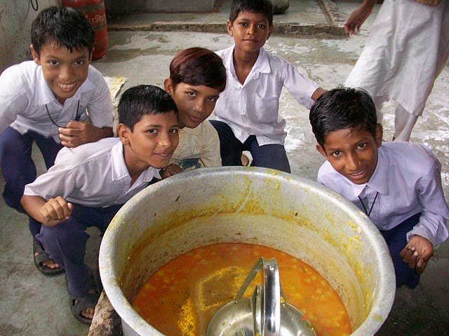
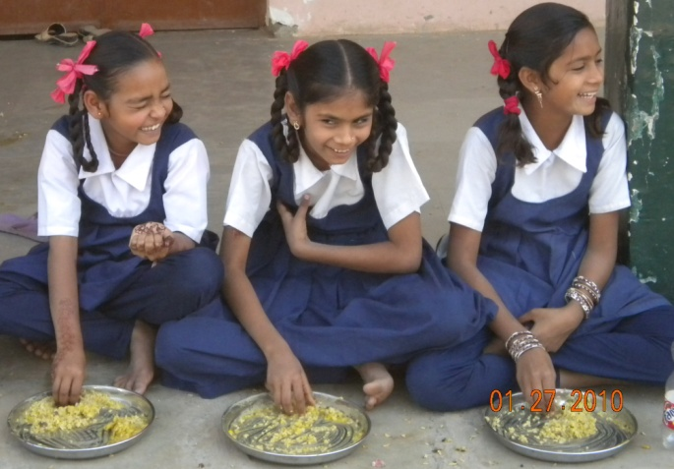
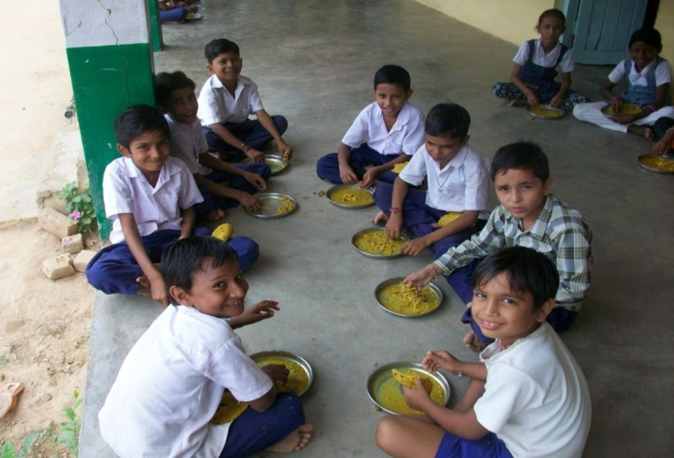
IMPACT OF MID DAY MEAL PROGRAMME ON THE GROWTH AND HEMOGLOBIN STATUS OF CHILDREN:
An Example Of Successful PPP in Gujarat
PROF. UMA IYER
GEETIKA DHAUNDIYAL

Slide 16
IMPACT EVALUATION STUDY COMPARING NGO (AKS) & GOVT. MDM PROGRAMME
SCHOOLS WITH MDMP
GANDHINAGAR
DEHGAM
AKSHAY PATRA N=1088
GOVT MDM
N=282
CLASSES
1st-7th
CLASSES 1st-7th
Anthropometric measurements, hemoglobin estimation and other indicators -
PRE-POST DATA
After 6 months
Uma Iyer & Geetika Dhaundiyal, 2010

Slide 17
PERCENT PREVALENCE OF UNDERNUTRITION (<-2 SD) Z SCORES AMONG CHILDREN IN AKS GROUP
BEFORE AND AFTER INTERVENTION
3%
THERE WAS A REDUCTION IN PREVALENCE OF THINNESS BY 9% WHICH WAS FOUND MUCH MORE EVIDENT (10%) IN GIRLS (p<0.01) THAN BOYS (4%).
Uma Iyer & Geetika Dhaundiyal, 2010

Slide 18
PERCENT PREVALENCE OF UNDERNUTRITION (<-2 SD) Z SCORES AMONG CHILDREN IN GOVT GROUP
BEFORE AND AFTER INTERVENTION
4%
THE PREVALENCE OF STUNTING RAISED BY 4% (p<0.01).
Uma Iyer & Geetika Dhaundiyal, 2010

Slide 19
SUMMARY OF FINDINGS
 | PERCENT CHANGE FROM BASELINE VALUES
PARAMETER STUDIED | AKS | GOVT
ANTHROPOMETRIC MEASUREMENTS
MEAN WEIGHT (kg) | 1.19 | 0.59
MEAN HEIGHT (cm) | 1.26 | 1.15
MEAN BMI (Kg/m2) | 0.43 | 0.09
PREVALENCE OF UNDERNUTRITION
UNDERWEIGHT STUNTING THINNESS | 1.9 0.5 5.3 | No change 4 0.3
HEMOGLOBIN LEVELS
MEAN HEMOGLOBIN LEVEL (g/dl) | 0.24 | 0.11
PREVALENCE OF ANEMIA | 18.1 | 0.1
Uma Iyer & Geetika Dhaundiyal, 2010

Slide 20
RECOMMENDATIONS
View I-ME Of FFS In Context Of The Total Program And Total MIS For All Activities
Focus Only On The Critical Tasks – Essential for achieving objectives
Rationalize Workload And Provide Administrative Support
Adopt Result Oriented MIS
Keep community contacts and home visits as one of the non-negotiable activities
Encourage PPP judiciously

Slide 21

Thank you!!

